Slide 1

Forest Fires in Parâmio, Portugal
This data is based on Montesinho National Park.
-Preetham Thelluri

Slide 2
Forest Fires – analysis with Multivariate data
It has 13 attributes and 517 samples.
For the sake of modelling, the map of the National Park was divided into a 9x9 square, with 9 zones on either direction i.e., X and Y.
The other attributes contain the independent factors about the fires: FFMC, DMC, DC, rain, wind, humidity, and ISI.
The final factor was the area burned – dependent variable.

Slide 3
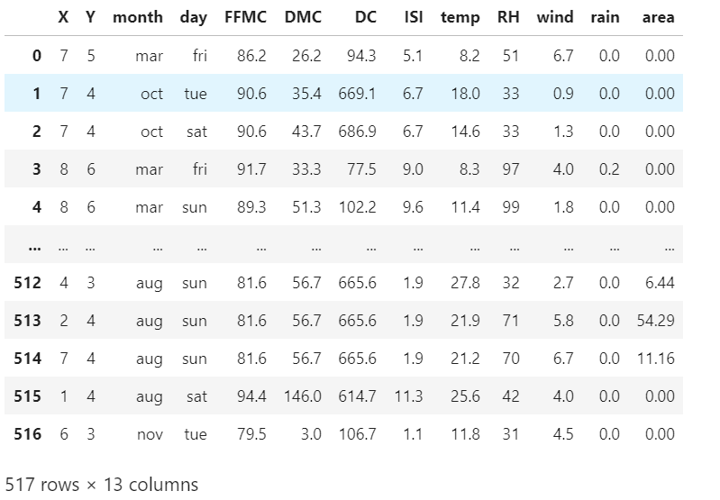
Data Sample

Slide 4
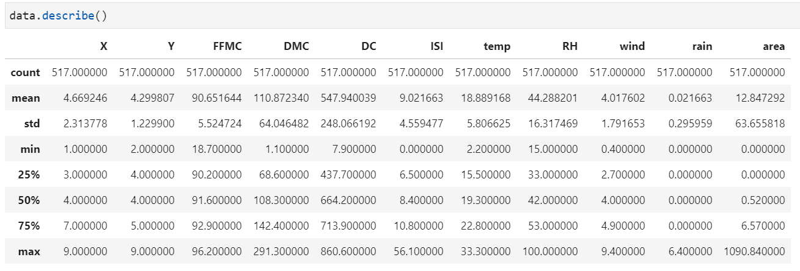
Statistics – some aren’t what they look like!

Slide 5
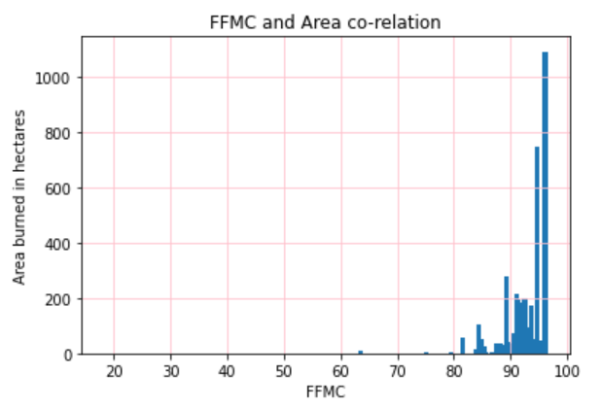
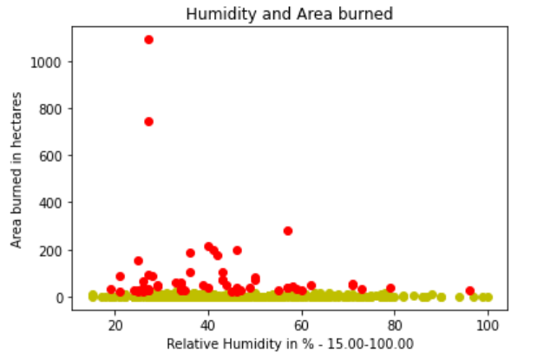
FFMC and Humidity w.r.t Area Burned
FFMC vs Area Burned
Relative Humidity (%) cs Area Burned

Slide 6
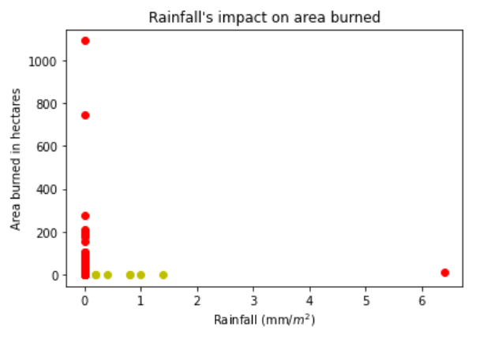
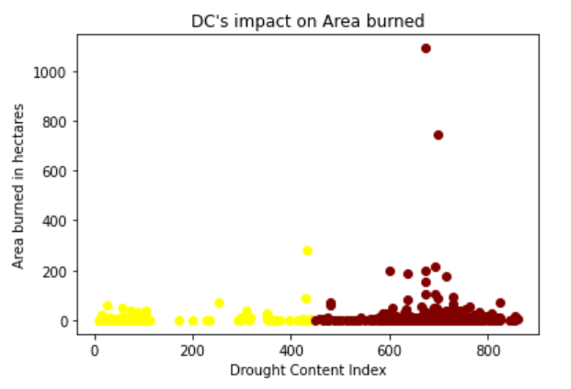
Rainfall and DC w.r.t Area Burned
Rainfall (mm/m^2) vs Area Burned
Drought Content index vs Area Burned

Slide 7
Motivation behind finalizing set values
Initially, I tried to experiment together with the Spreading Index, Duff Moisture Content, Drought Content, and Month.
However, I found out that there were discrepancies in common thought and data.
I realized that some factors I picked were a combination of a few more basic factors, so I decided to pick FFMC, Rainfall, Drought Content, and Humidity.
They had the least reliance on one another, and they provided me with accurate results. I was able to clearly tell the causation and correlation.
I attempted to do the regression model, but most of the values were eschewed towards 0. Later, I realized that I could convert hectares to a smaller unit, or use a logarithmic scale.

Slide 8
Findings
Temperature, FFMC (Fine Fuel Moisture Content), DC (Drought Content), ISI (Initial Spread Index), wind, and DMC (Duff Moisture Code) are directly proportional to the area burned.
Humidity and rain are inversely proportional to the area burned, as they reduce the damage with their increase.
This is a multivariate data set, and there needs to be a collection of conditions to create the most/least destructive fire.
Some of the conditions go hand-in-hand, Drought Content and Fine Fuel Moisture content.
Some cannot exist with the existence of another, like low temperatures and high Initial Spread Index – which fluctuates by time.

Slide 9

Thanks for watching!

